Slide 1

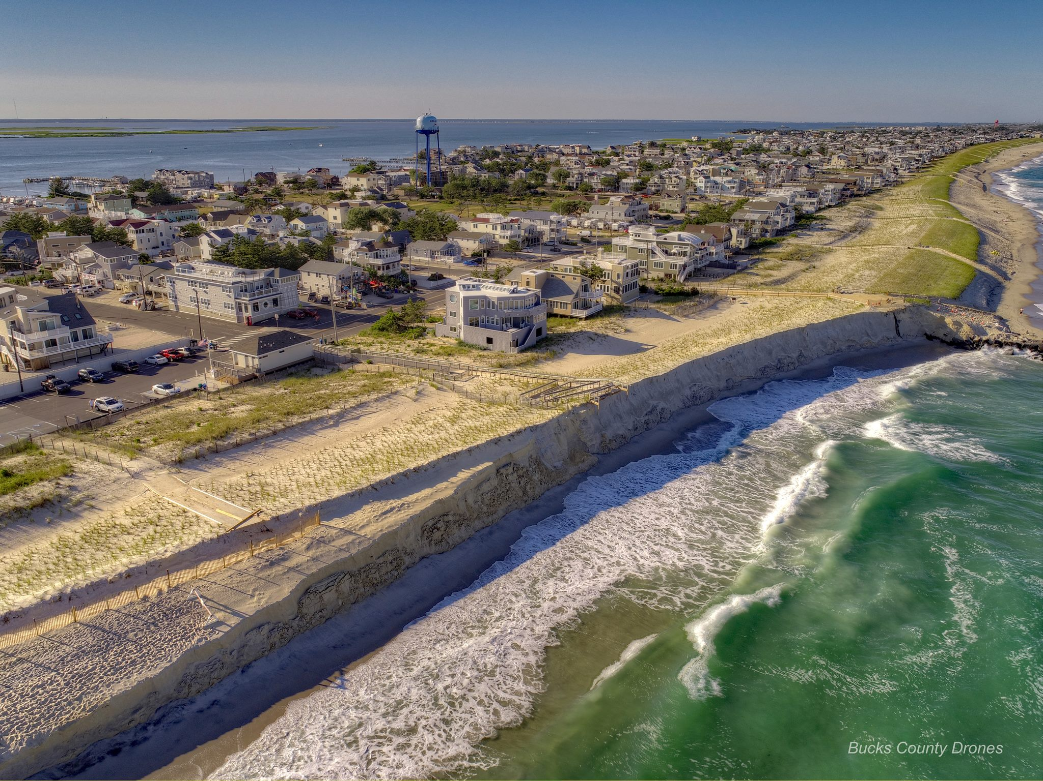
STOCKTON UNIVERSITY COASTAL CENTER
LBI RESEARCH INITIATIVES
Dr. Stewart Farrell &
Ms. Kimberly McKenna
Coastal Research Center
Wednesday, August 1, 2018

Slide 2
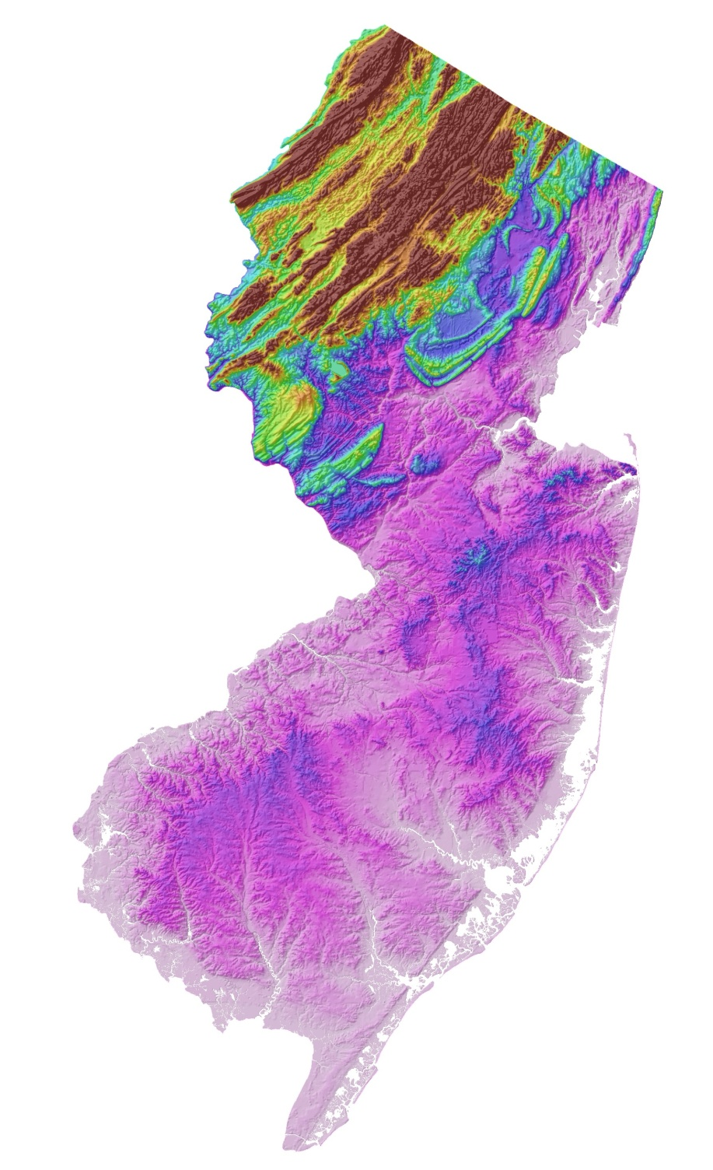
New Jersey’s Coastline is about 130 miles long.
The Coast contains eroding bluff shorelines in the north and barrier island complexes in the south.
Long Beach Island is a barrier island that divides the NJ coastline.

Slide 3
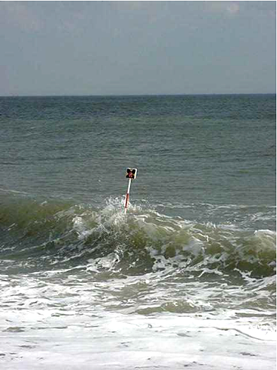
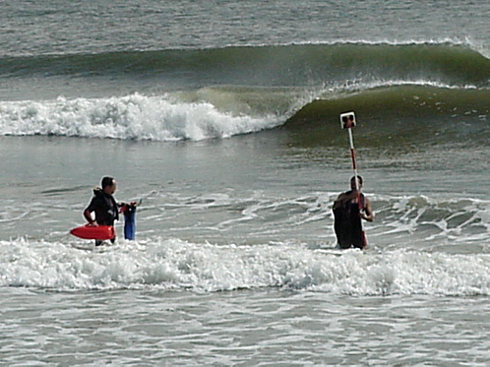
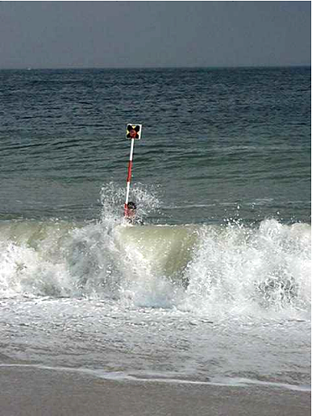
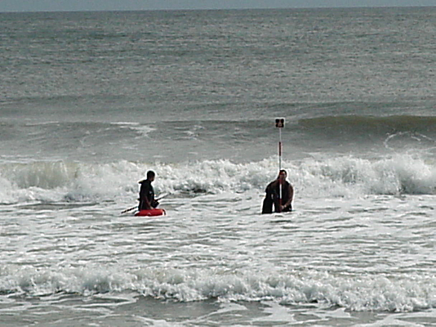
Beach Surveys Cover More Than the Beach
Typical Conditions

Slide 4
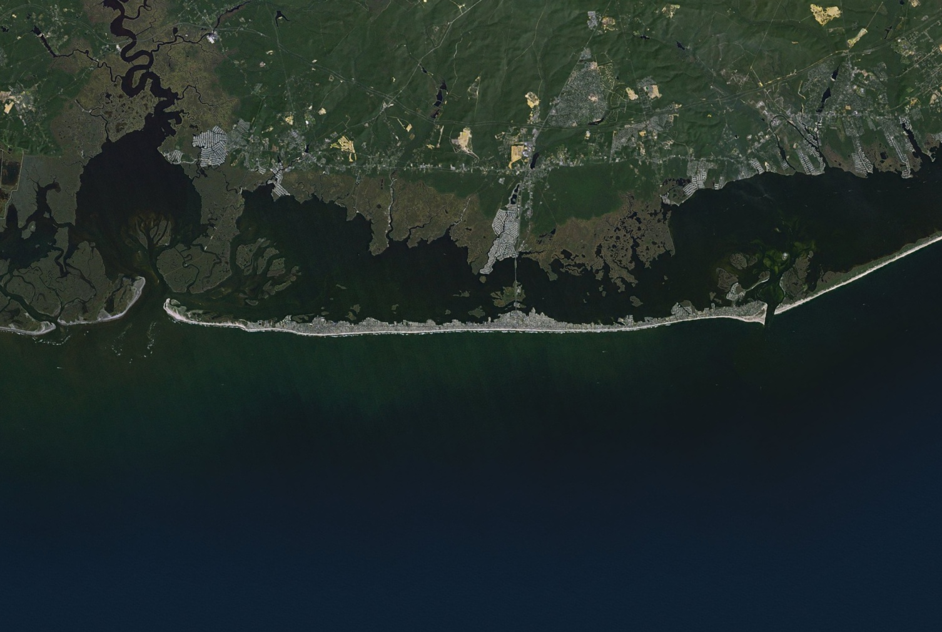

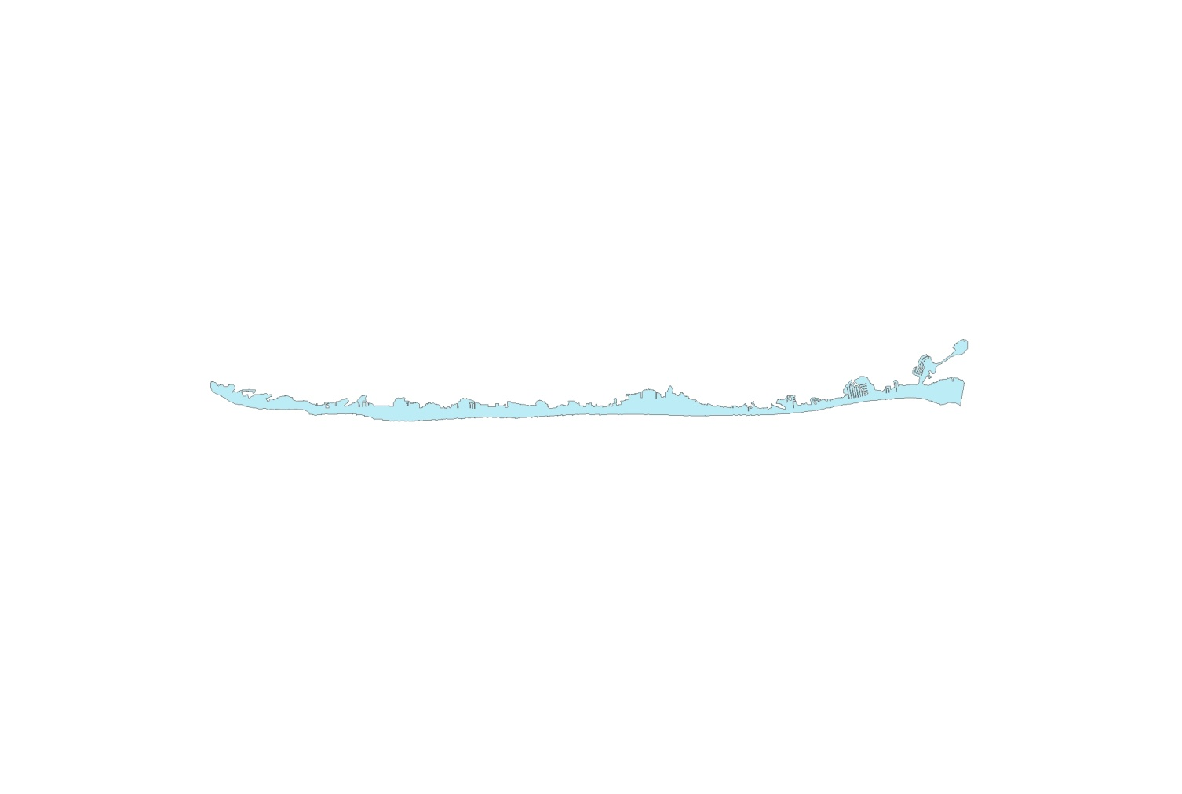
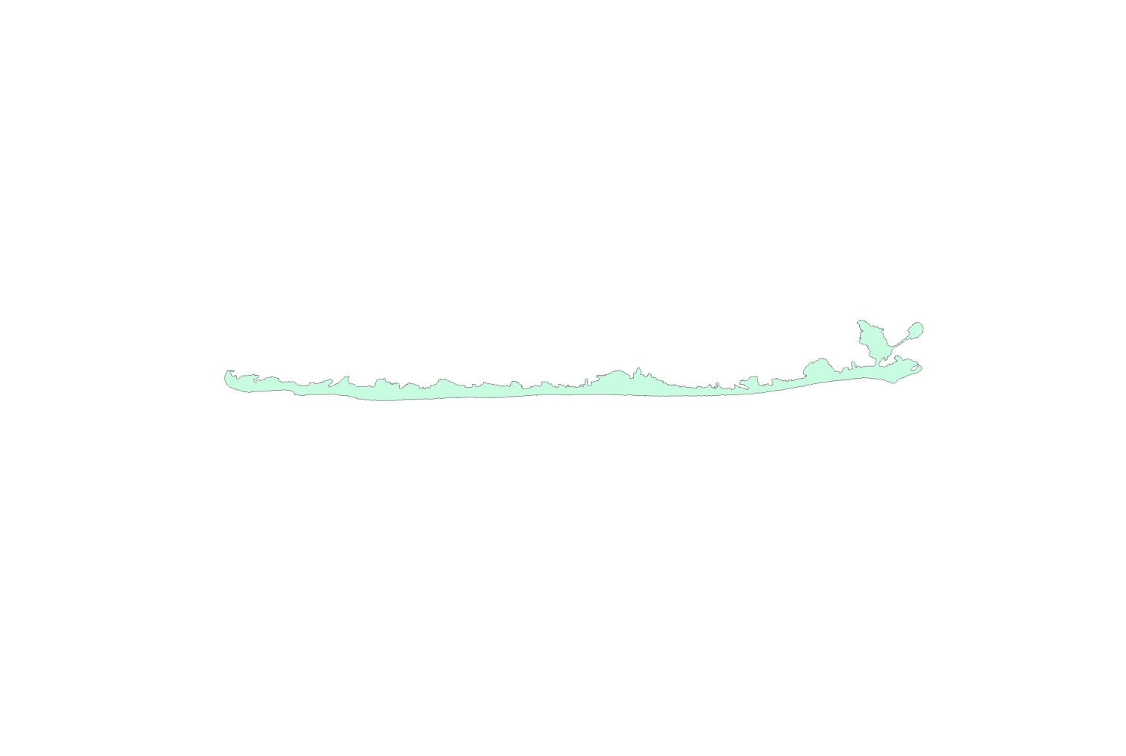
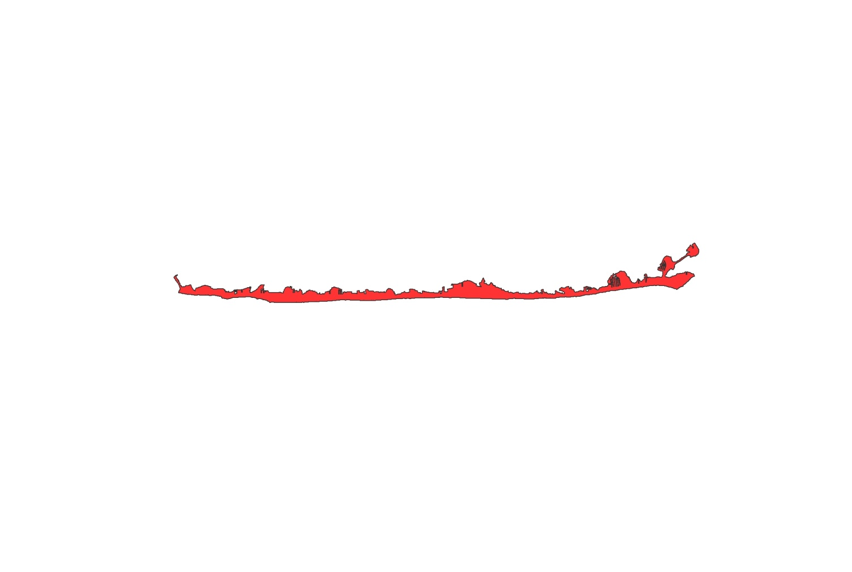
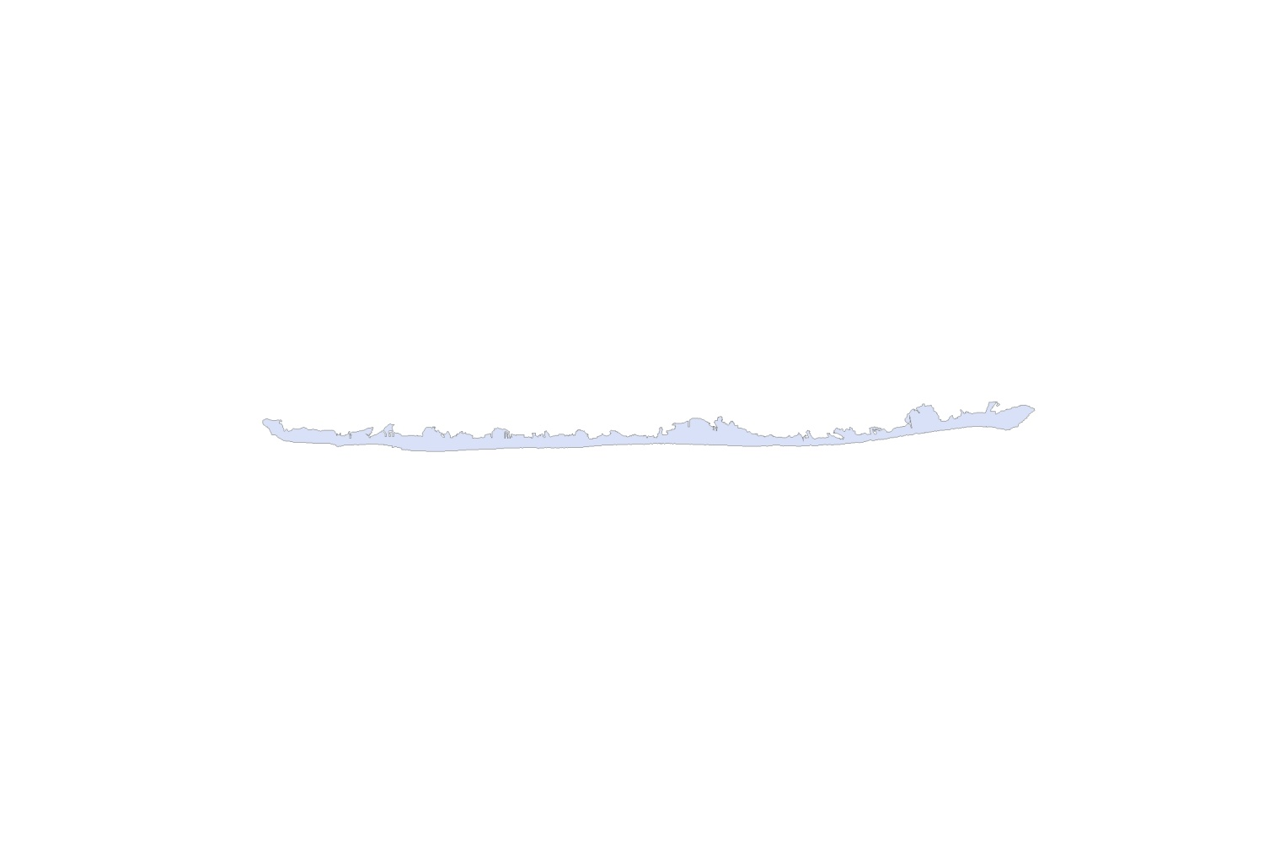

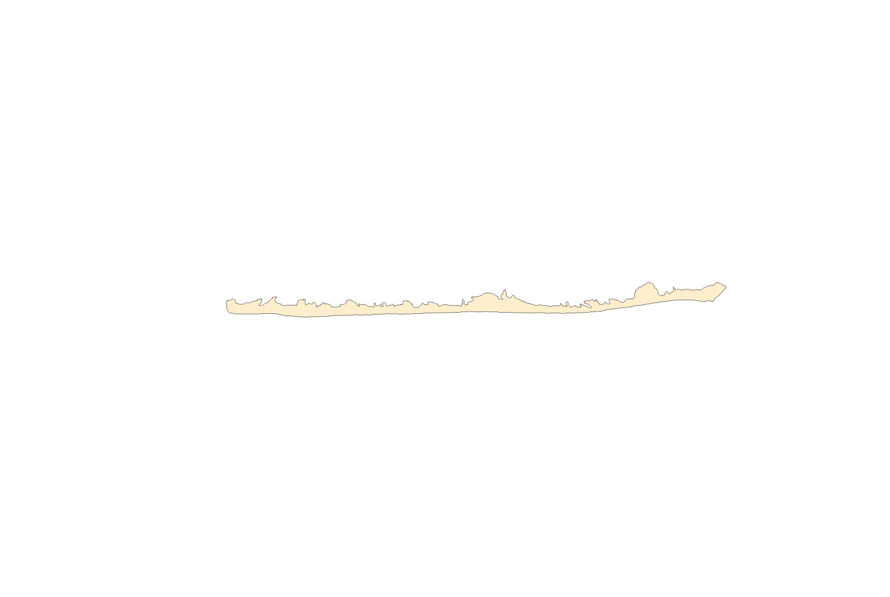
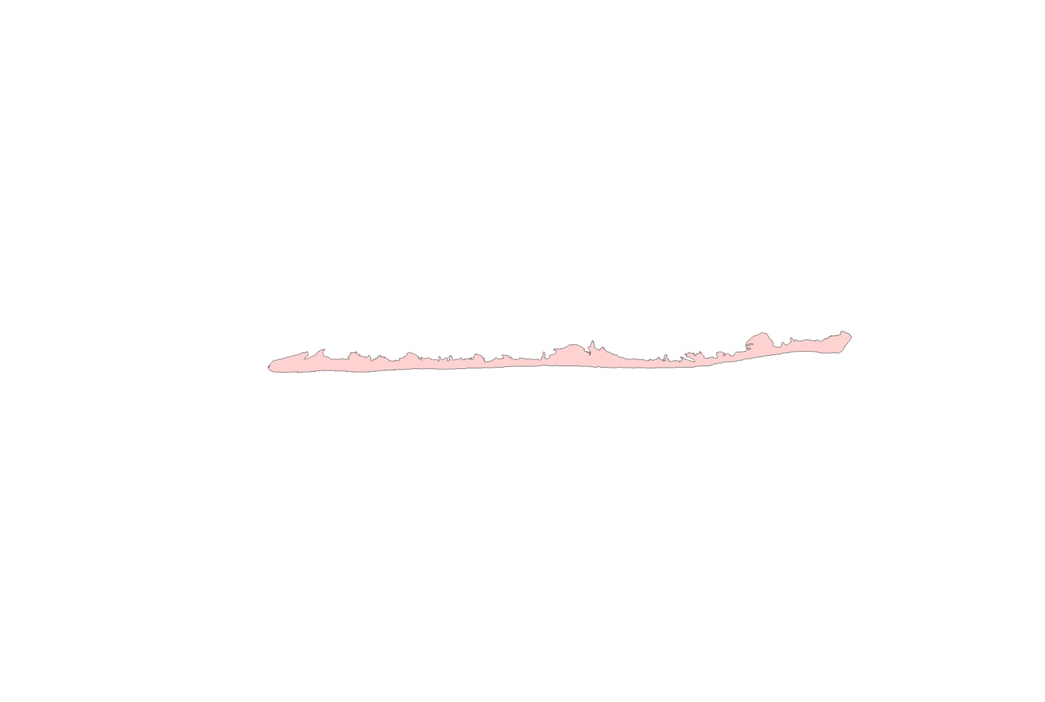
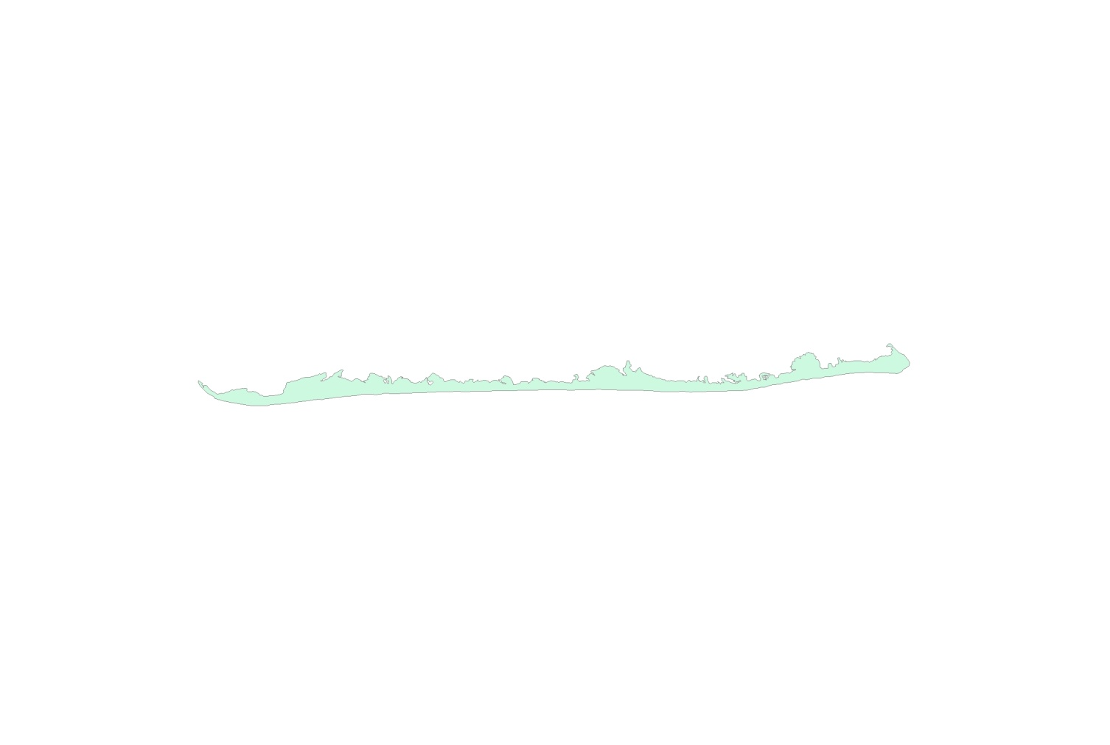
1944
1962
1995
2002
1879
1920
1931
1955
1986
LBI Shoreline Change
1879 - 2010

Slide 5
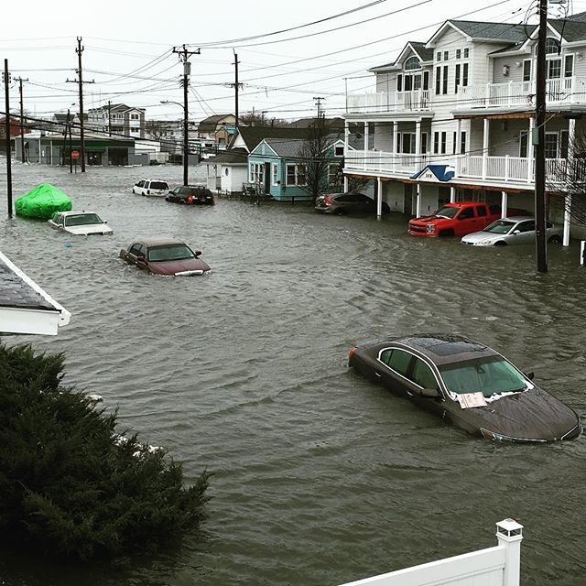
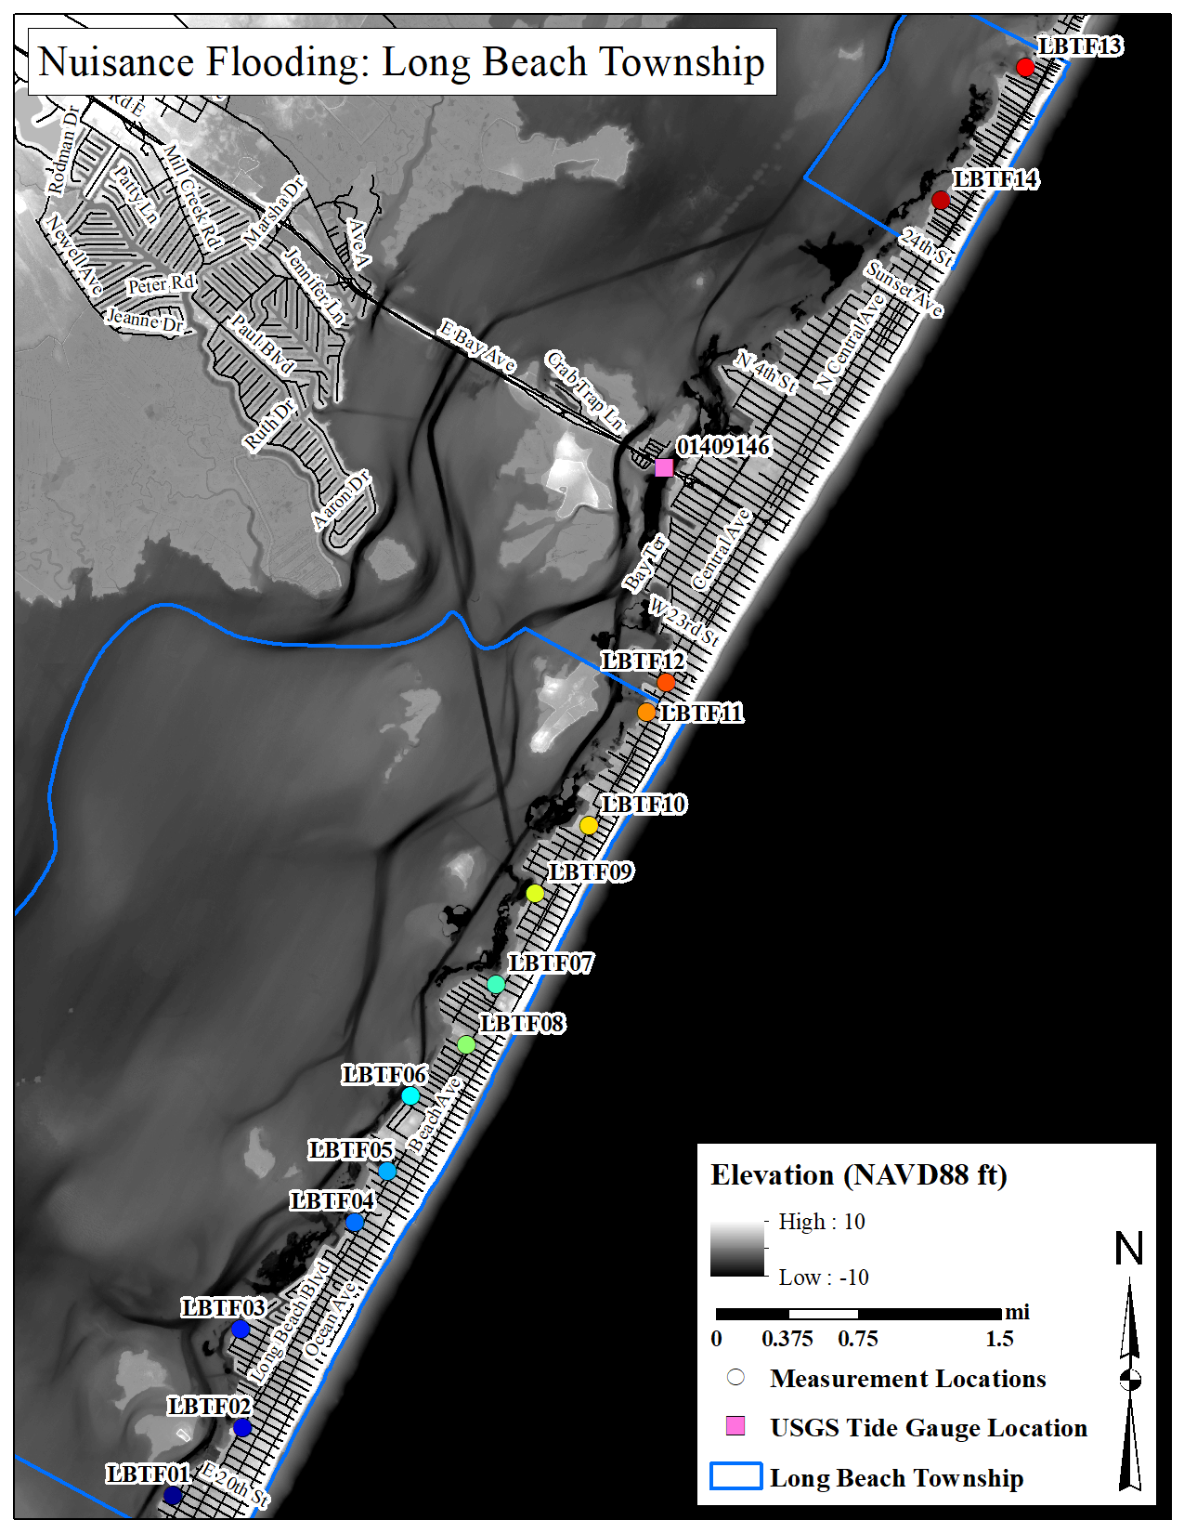
Nuisance Flooding

Slide 6
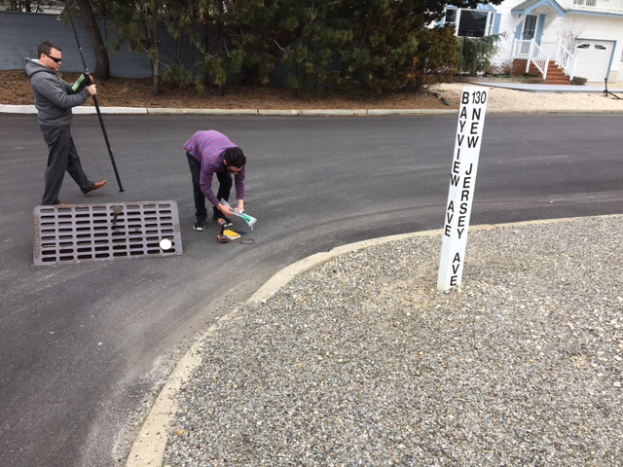
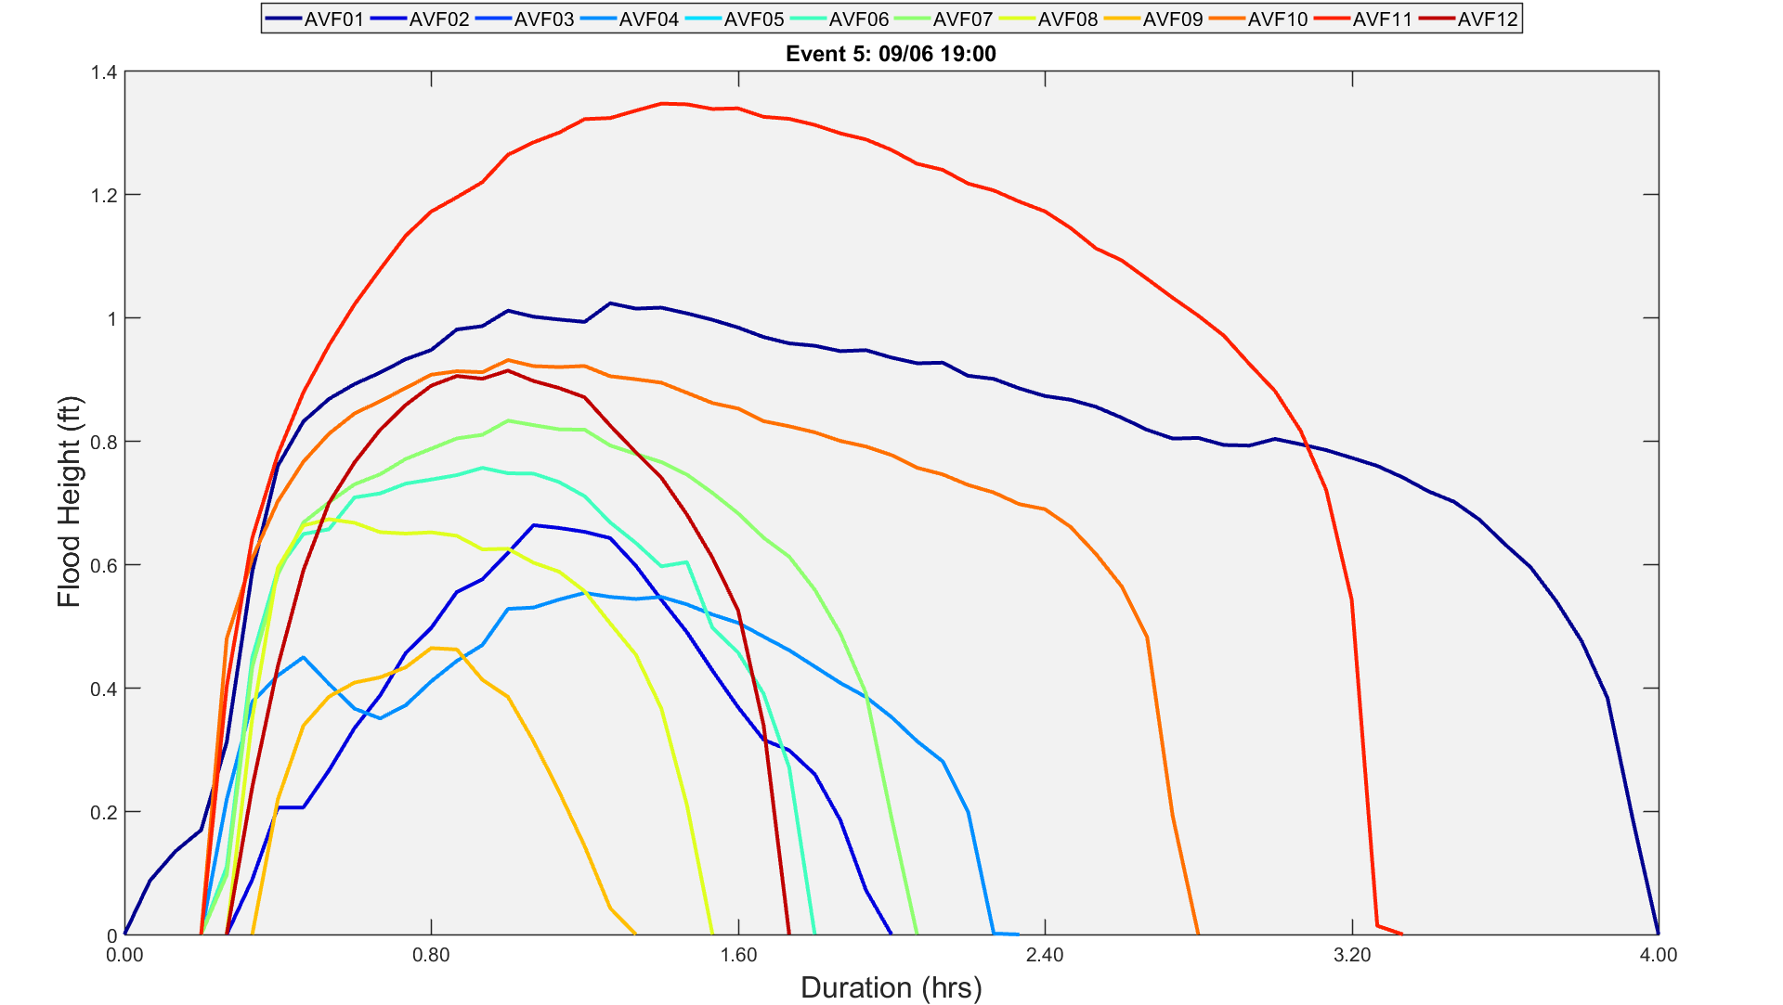
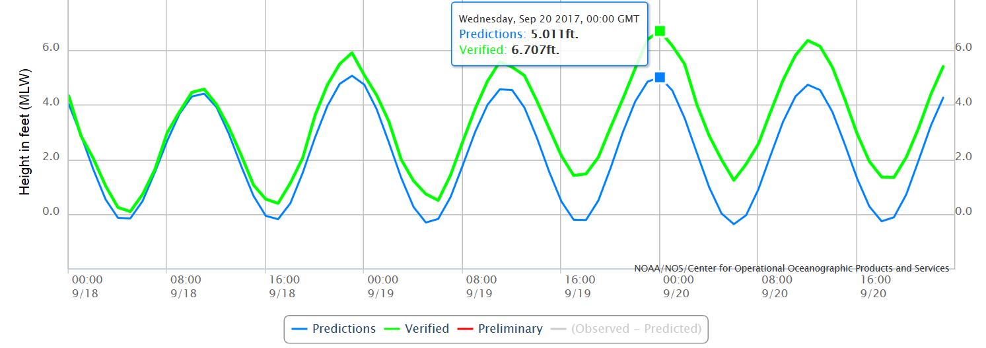
Nuisance Flooding

Slide 7
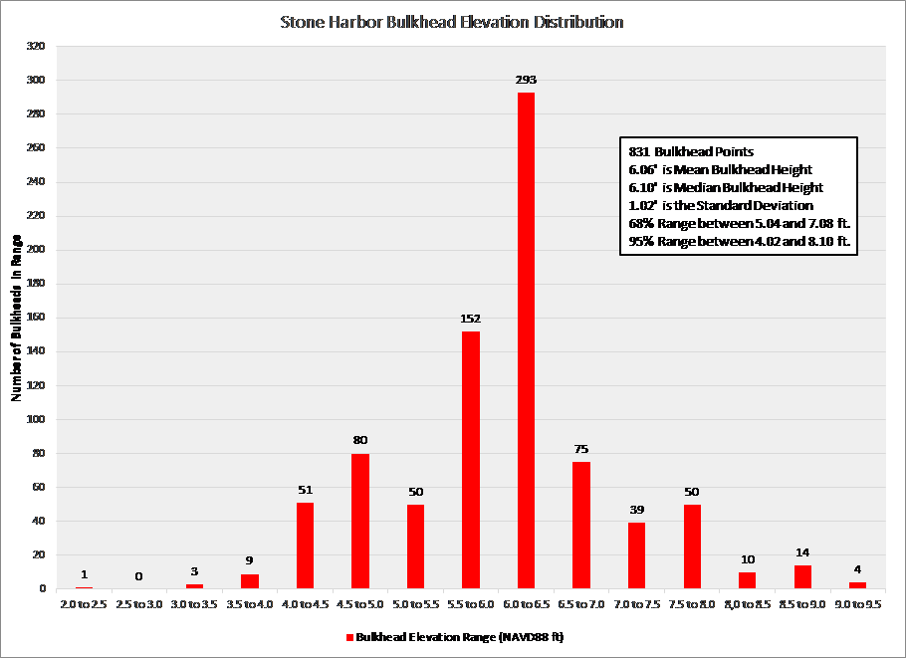
Bulkhead Elevations

Slide 8
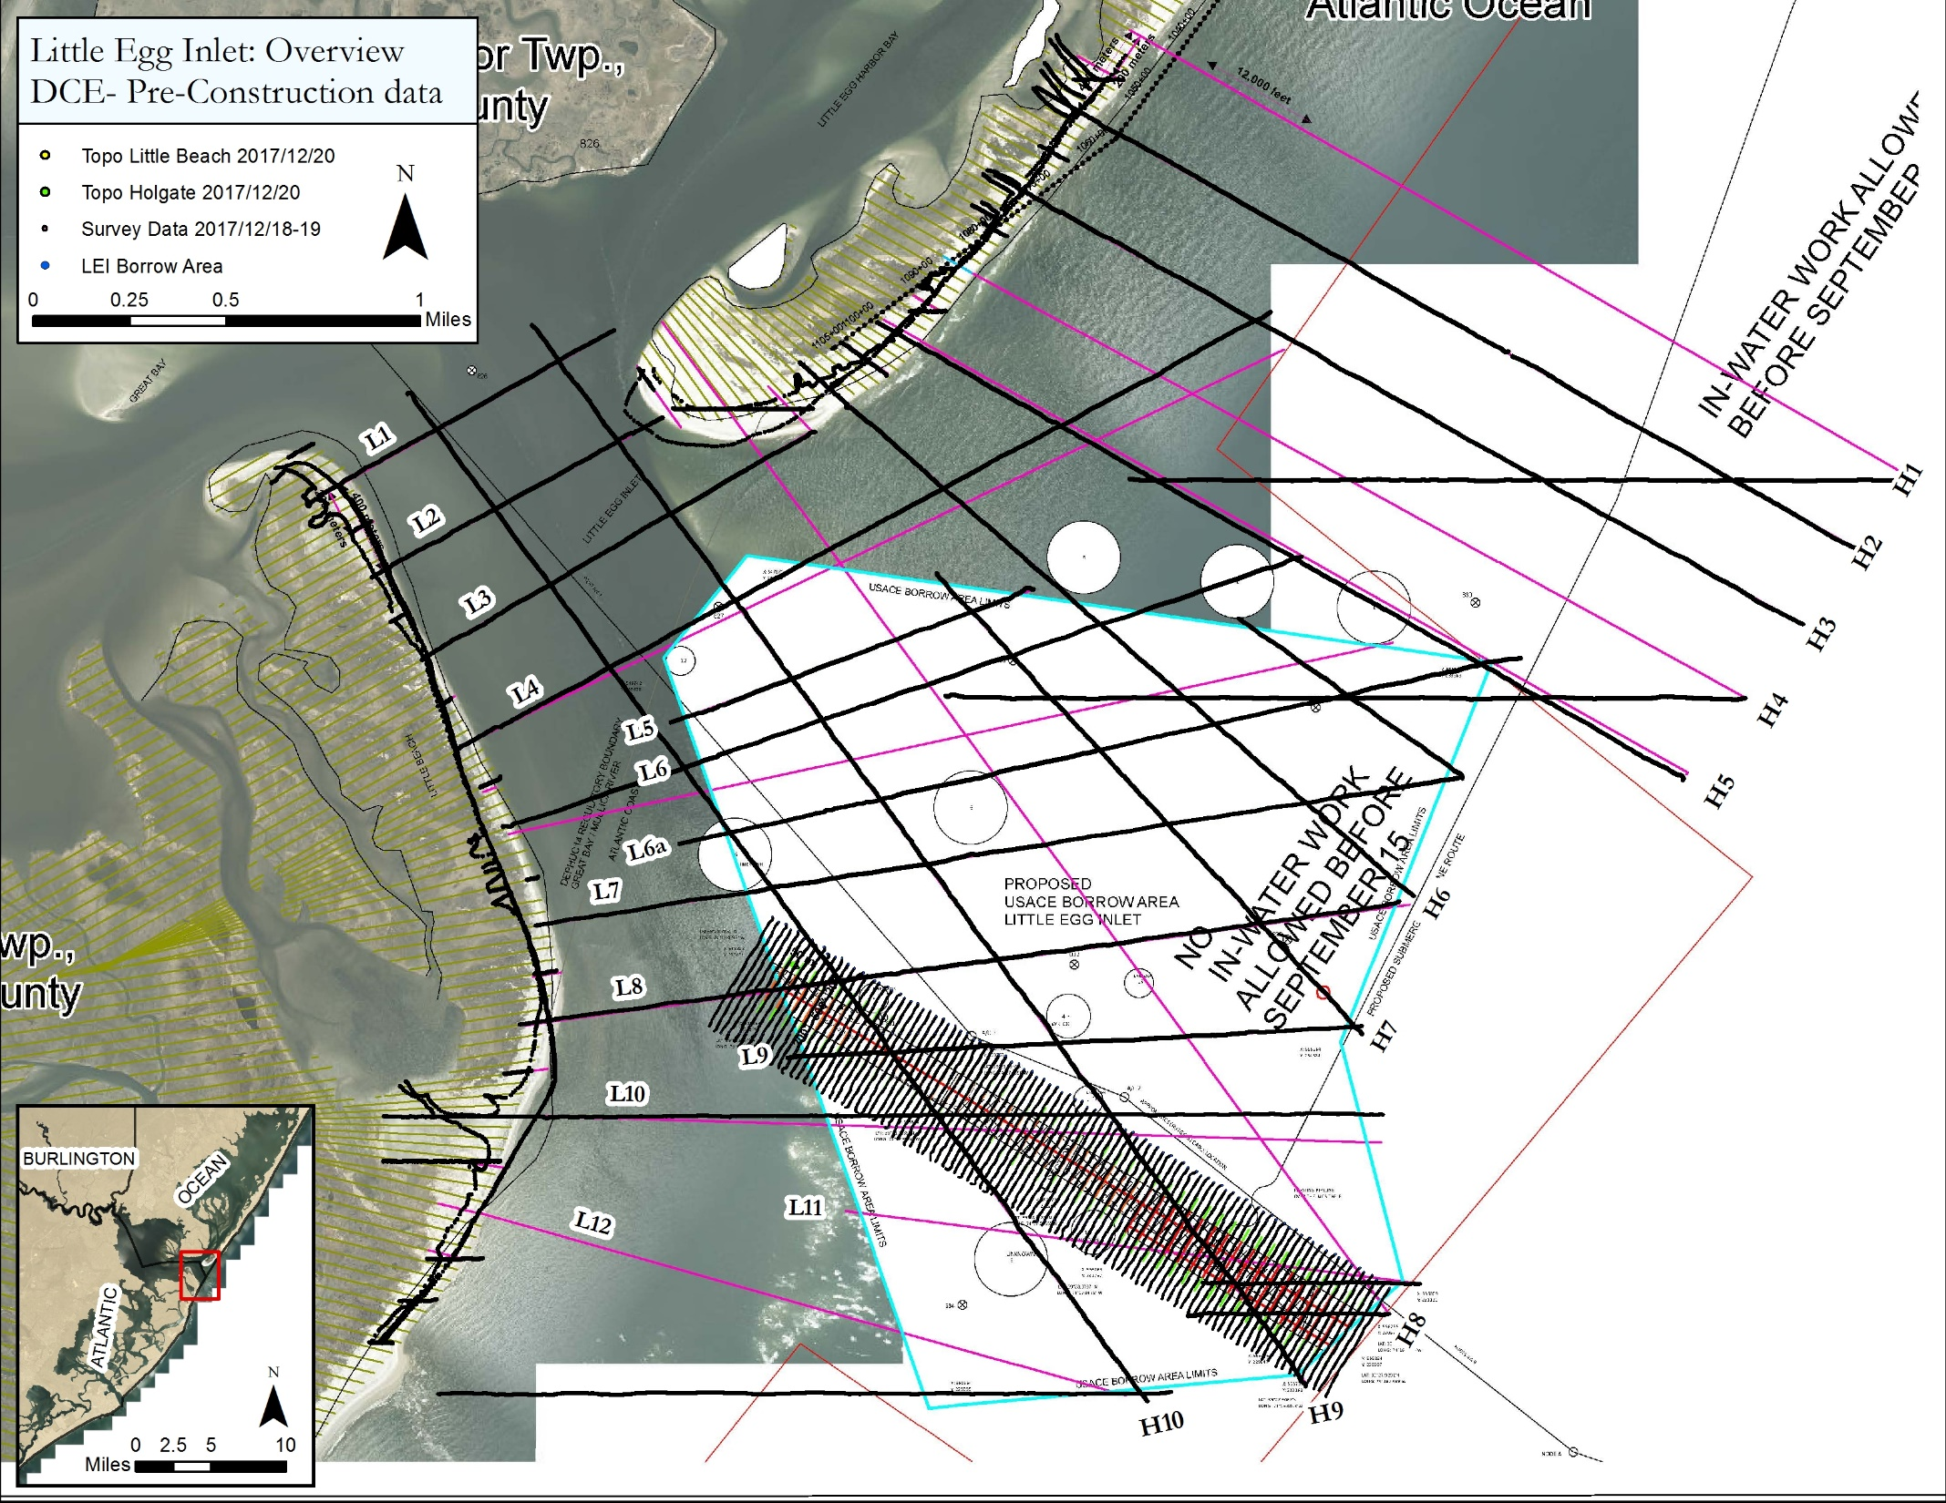
Little Egg Inlet Maintenance

Slide 9
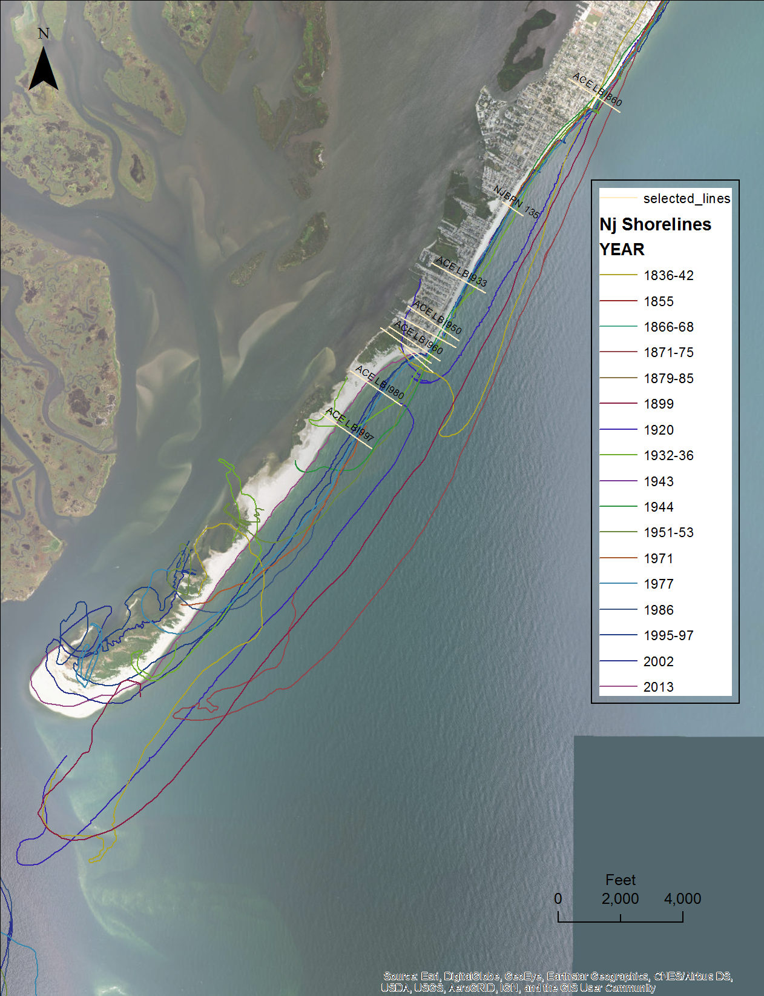
Holgate Terminal Groin: Field Evaluation & Conceptual Design
(Jan 2017-June 2017)
Holyoke Groin
Jeffries Groin
CRC OBJECTIVES:
Evaluate beach and nearshore conditions
Develop a conceptual design for replacing the Holgate Terminal Groin (wooden jetty)
Washington
Groin
Holgate
Terminal Groin

Slide 10
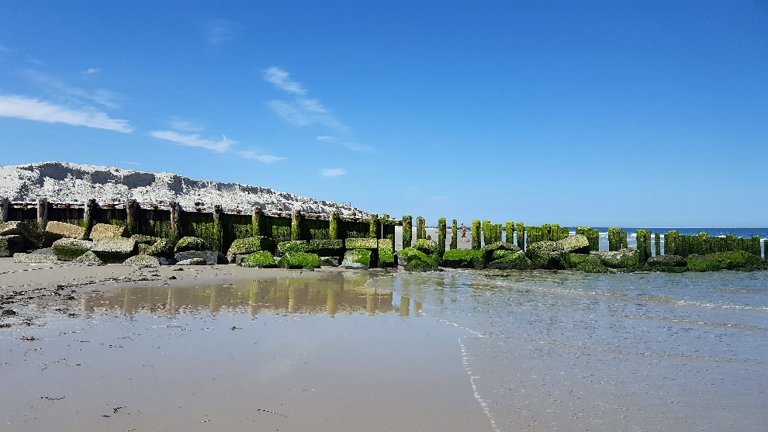
Holgate Terminal Groin: Field Evaluation & Conceptual Design
(Jan 2017-June 2017)
RAPID EROSION DUE TO:
Groin in poor condition – too porous, too low, too short
Large shoreline angle results in localized increase in longshore transport
Abrupt transition between groin field (north) and area without groins (NWR)
Abrupt transition between beach fill (north) and area without fill (NWR)
Southern end of LBI strongly influenced by Little Egg Inlet
Between Jan 2017 and June 2017, the study area was impacted by nine coastal storms with wave heights of greater than 5 ft.
Cumulative volume changes updrift of groin were -526,975 cy; south of groin were 186,000 cy
June 26, 2017

Slide 11
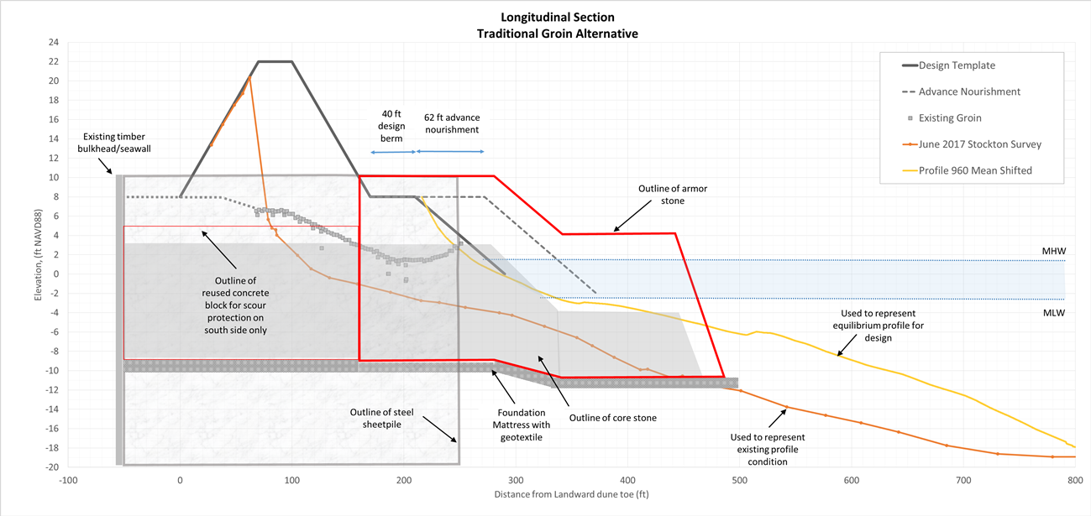
Holgate Terminal Groin: Field Evaluation & Conceptual Design
(Jan 2017-June 2017)
CONCEPTUAL DESIGN GOALS:
Protect USACE beach fill & hold design beach/dune template and advance fill
Bypass 95,000 cy/year to return to pre-fill conditions & allow some sand into the NWR to slow prevailing erosion
Be adjustable if monitoring shows it is not effective in holding the beach fill or in bypassing sand
May require supplemental sand through beach fill from offshore source or sand backpassing from Little Egg Inlet
Traditional impermeable, notched, and leaky groin designs considered.
SELECTED DESIGN: TRADITIONAL

